Slide 1

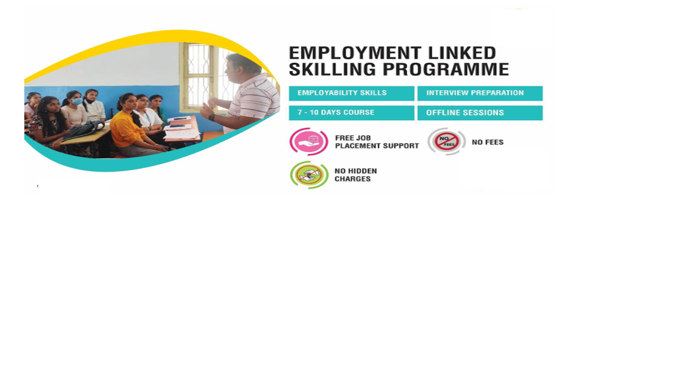

Slide 2
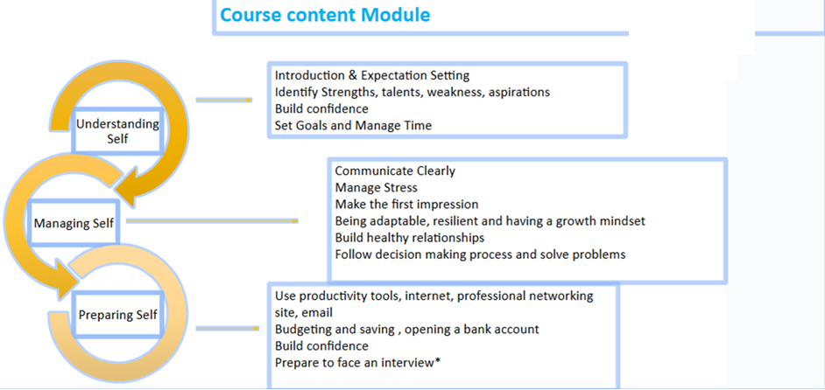

Slide 3
Course content Module
Connect With Work - Offline Framework |  |  |  |  |  | Microsoft Office
# | Module | Session Name | Duration (mins) | Learning Outcome/s After completing the Topic participants will; |  | # | MS Office | Duration (mins) Offline | Duration (mins) Self-learning
1 | Life Skills | Introduction & Understanding Self (Offline) | 270 | Know more about Magic Bus and the programme Understand themselves better, i.e. become more self-aware |  | 1 | MS Word | 120 | 130
 |  | Managing Self (Offline) | 630 | Communicate clearly Manage Self Learn to build healthy relations, Understand the importance of team work and managing conflicts. |  | 2 | MS Excel | 360 | 310
2 | Employability Skills | Preparing Self (Offline) | 540 | Use productivity tools* Use internet and email. Understand simple budget Process to open a bank account Understand how to be safe and maintain ethics at work Be ready to face an interview and join a formal workplace |  | 3 | MS PowerPoint | 60 | 150
 |  | Microsoft Office - Offline | 600 | Introduction to Word, Excel PowerPoint, Teams, SharePoint and One Drive |  | 4 | MS Teams, SharePoint, One Drive | 60 | 145
 |  | Microsof Office - Self Learning | 735 | Introduction to Word, Excel PowerPoint, Teams, SharePoint and One Drive |  |  | Total Duration (mins) | 600 | 735
 |  |  |  |  |  |  | Total Duration (hrs) | 10 | 12.25
 |  | Duration in minutes (Offline) | 2040
 |  | Duration in hours (Offline) | 34

Slide 4
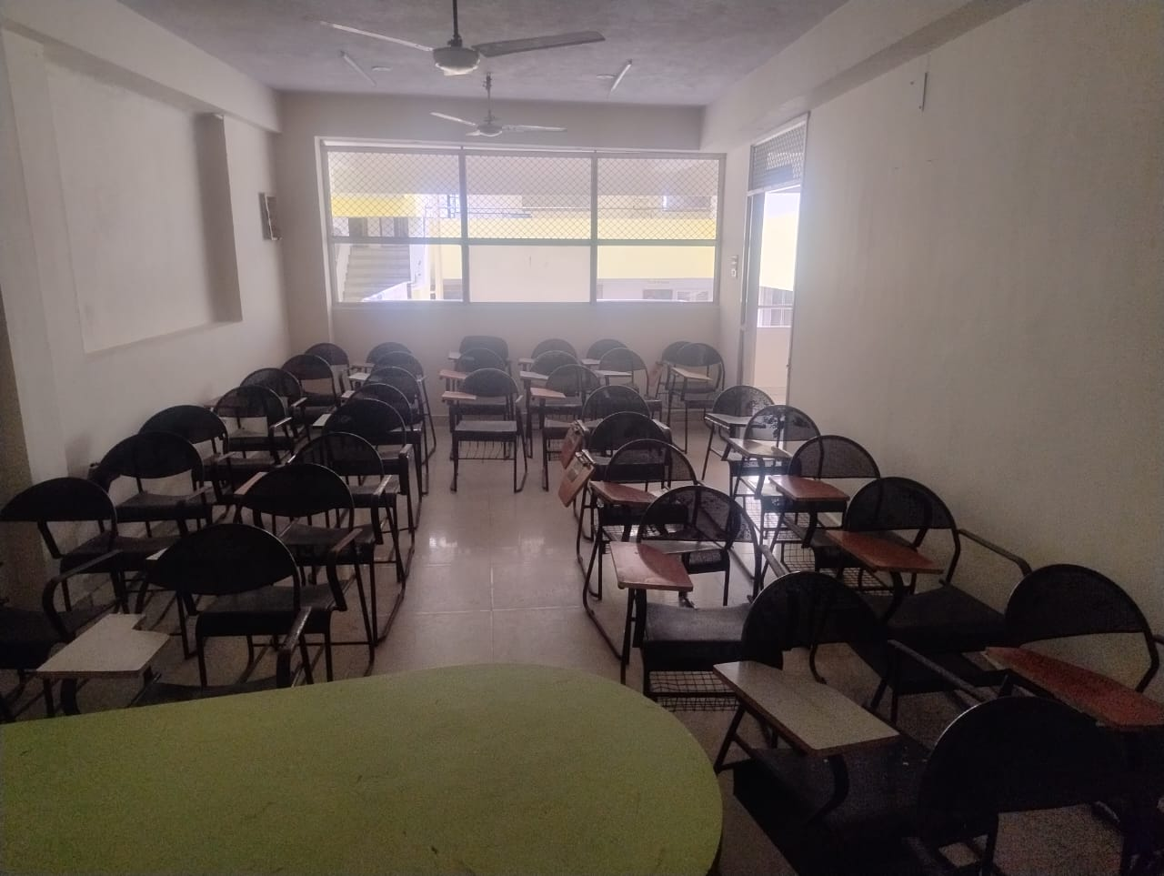
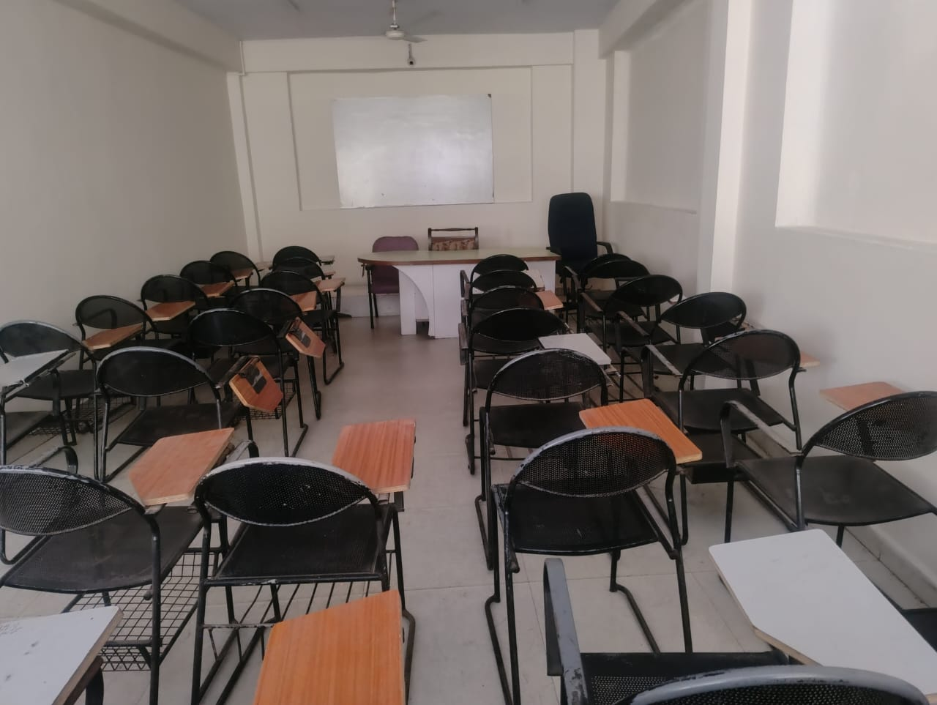
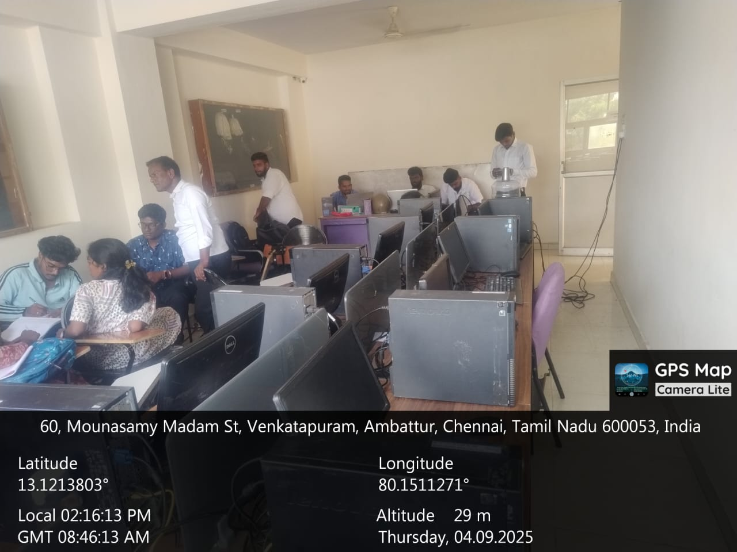
Class Room & Computer lab

Slide 5
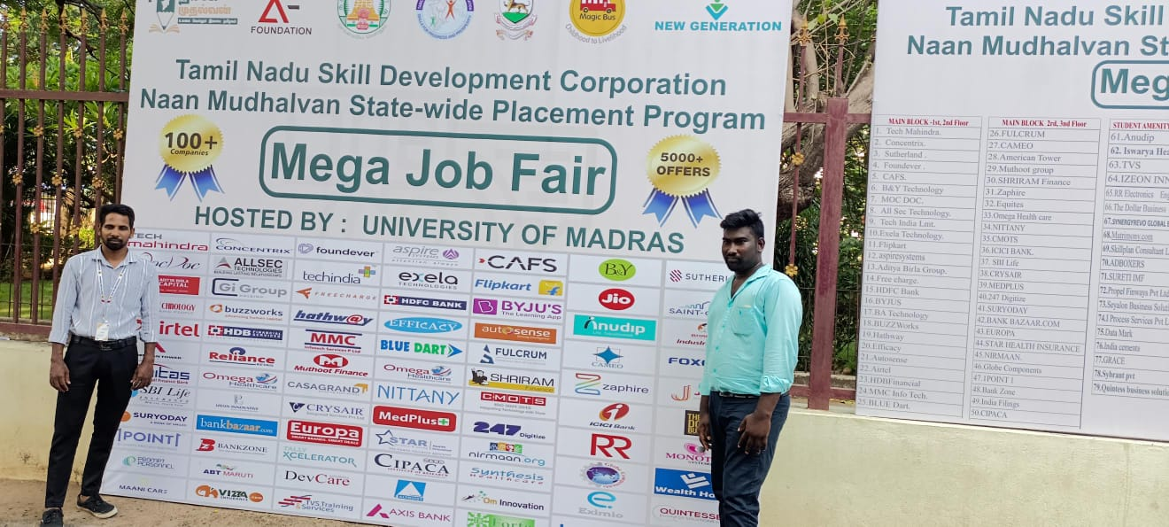
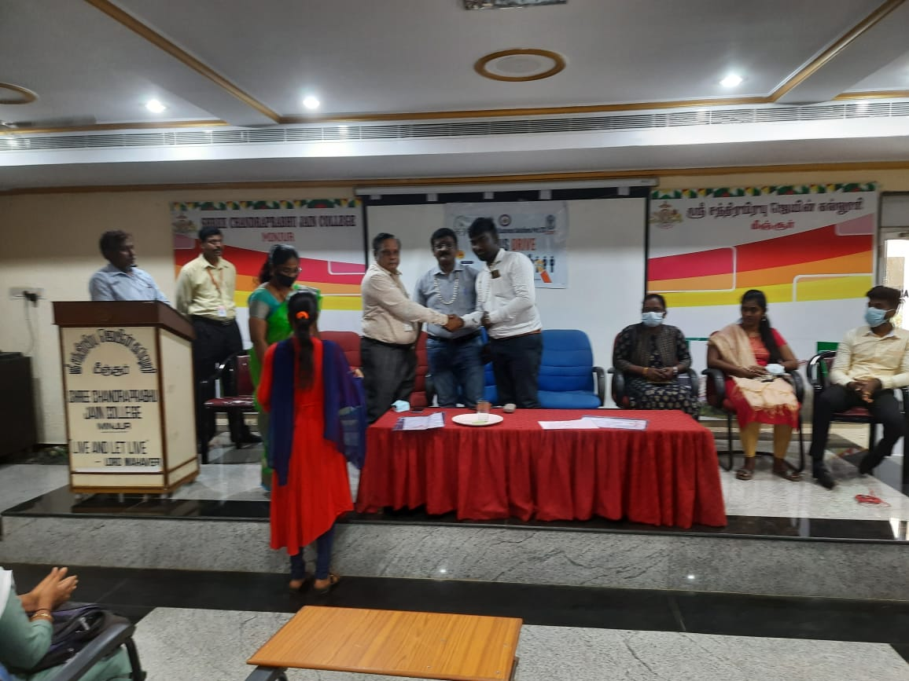
Job drive Collateral of other NGO’s

Slide 6
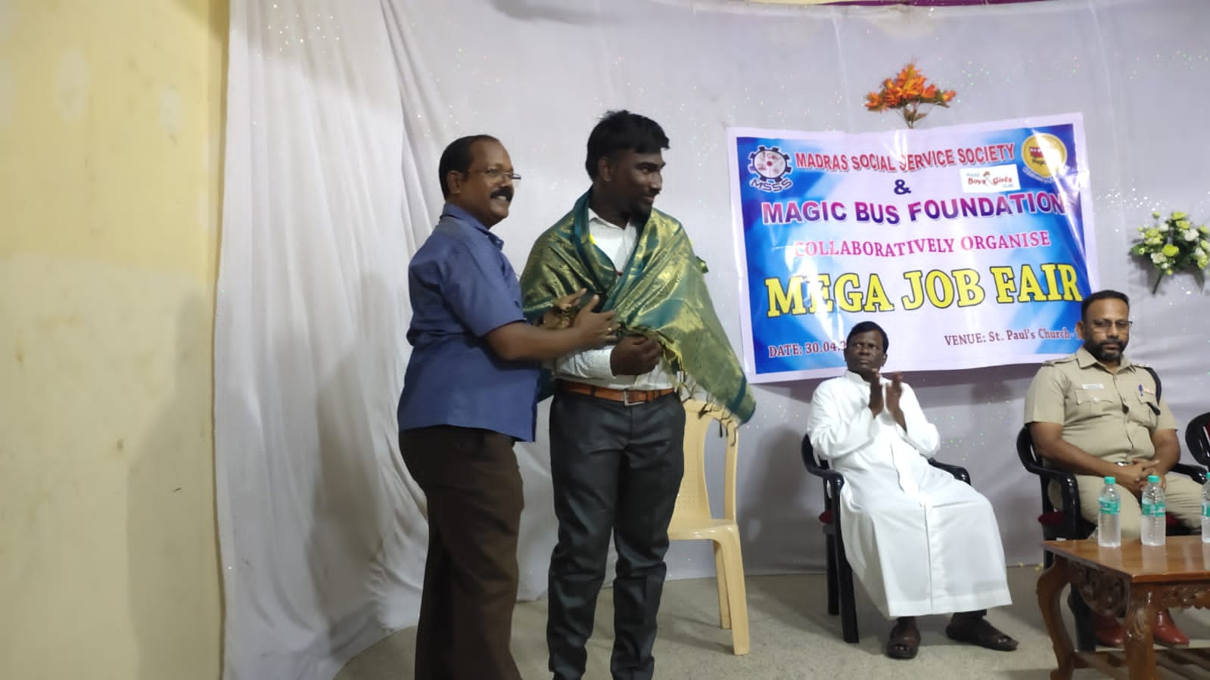
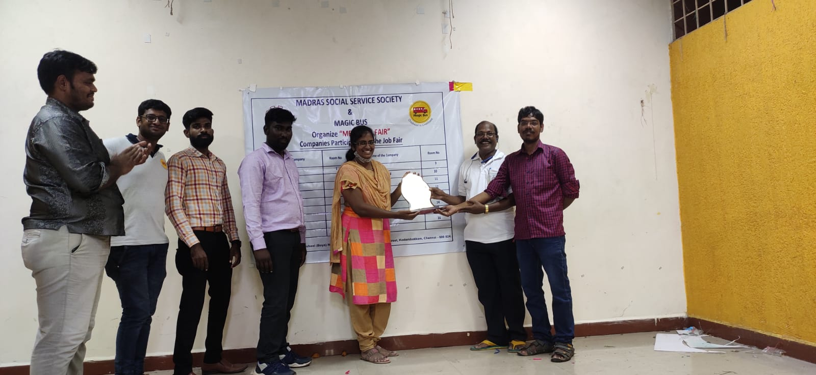
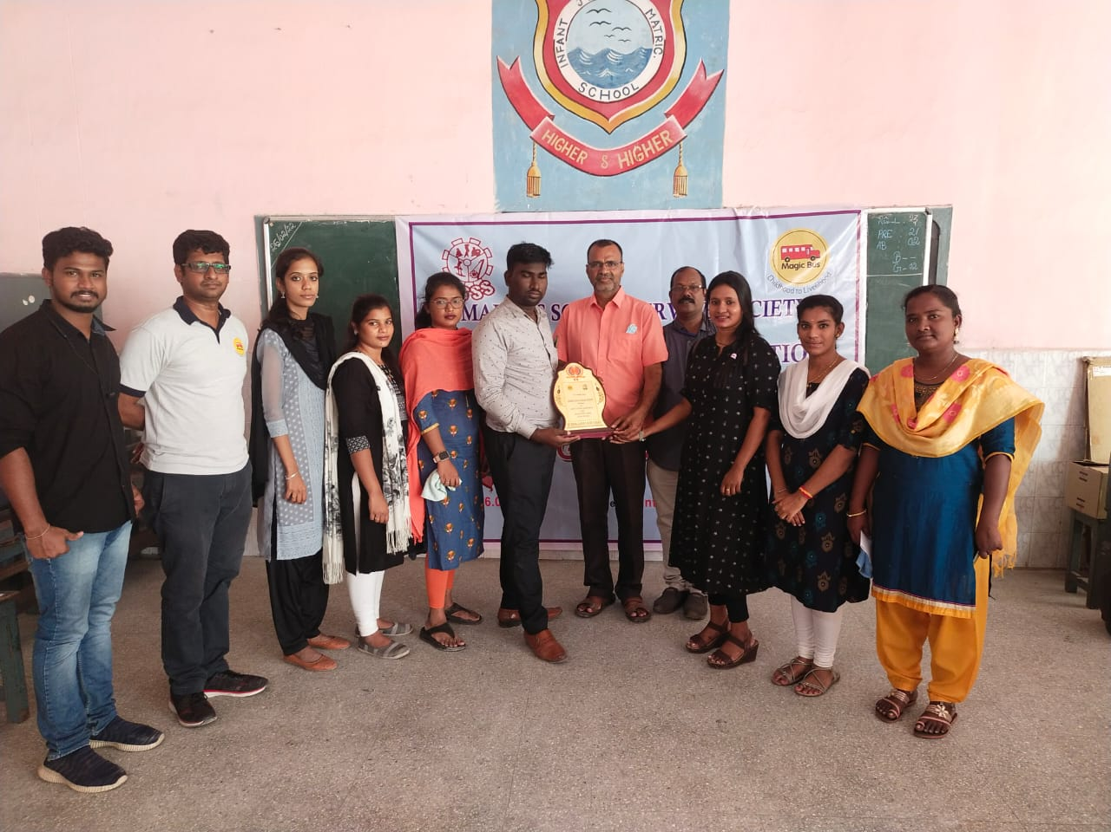
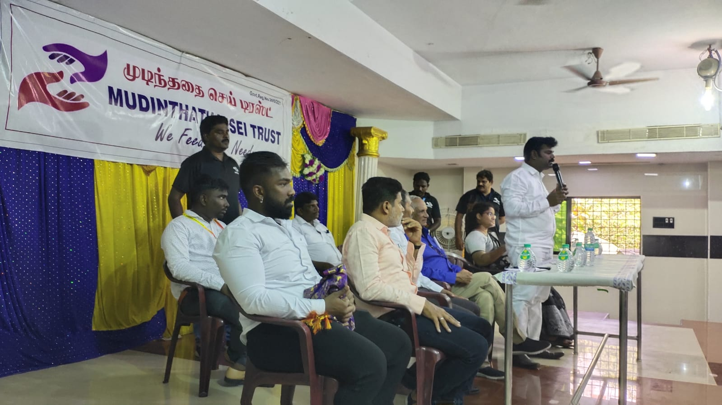

Slide 7
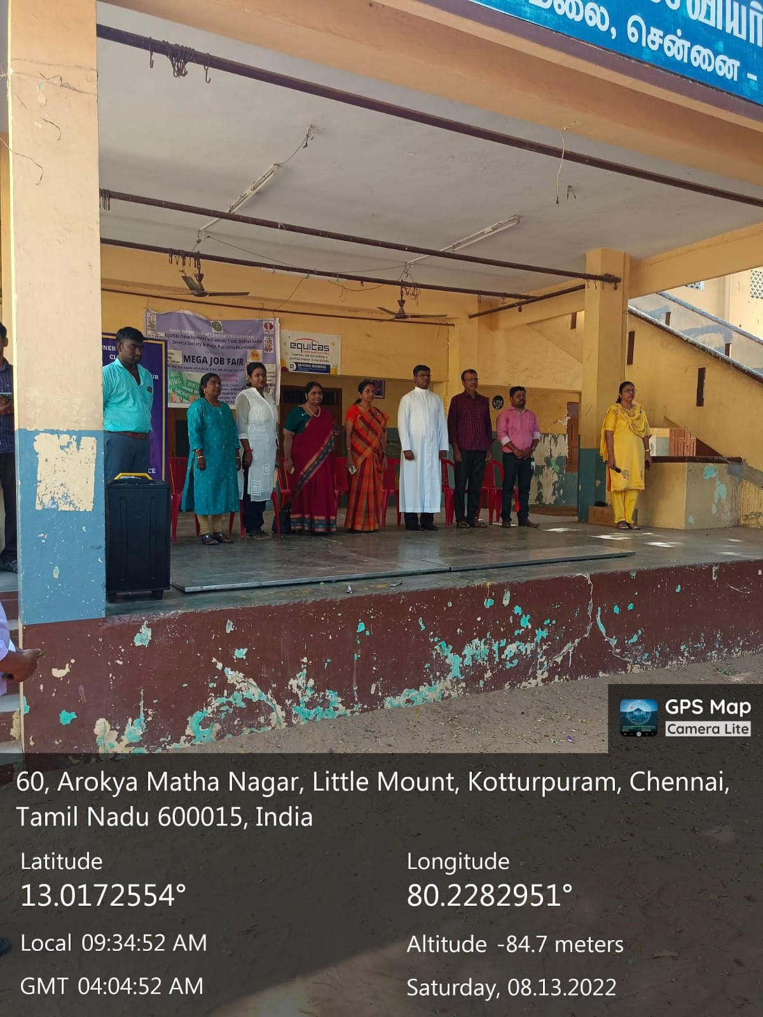
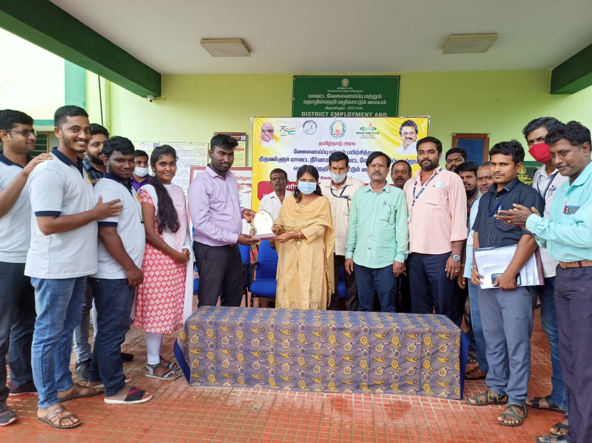

Slide 8
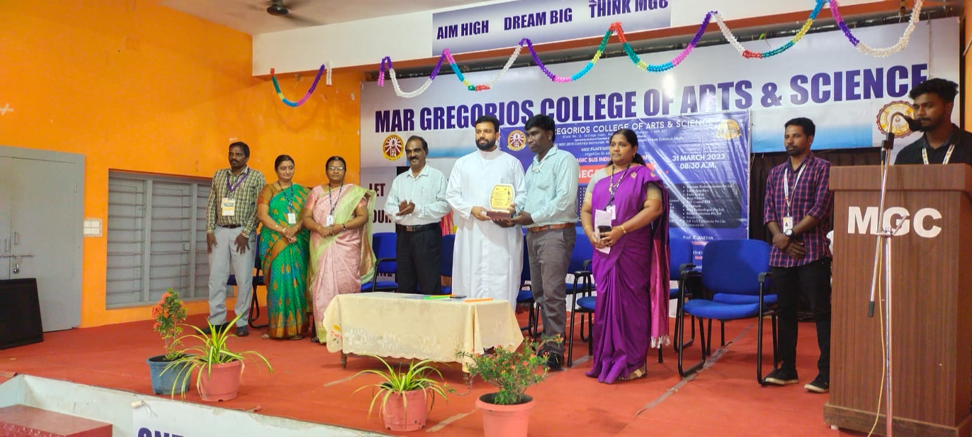

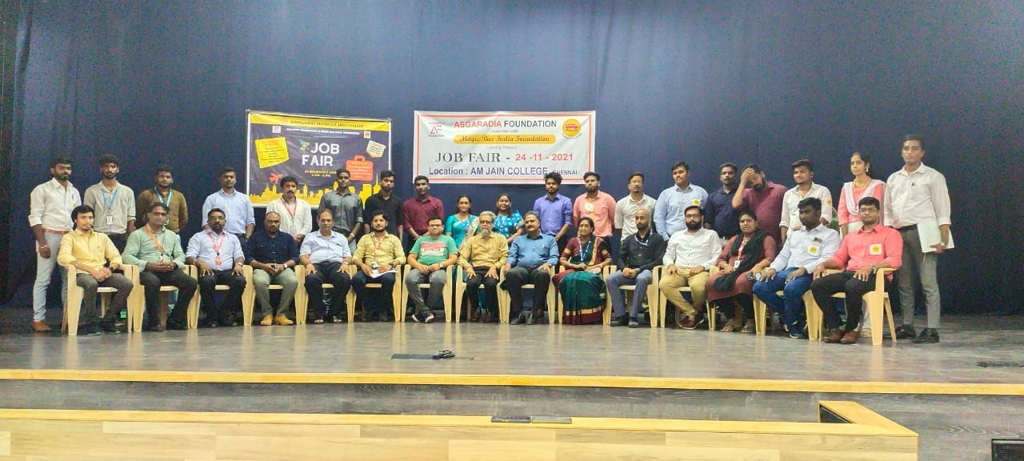
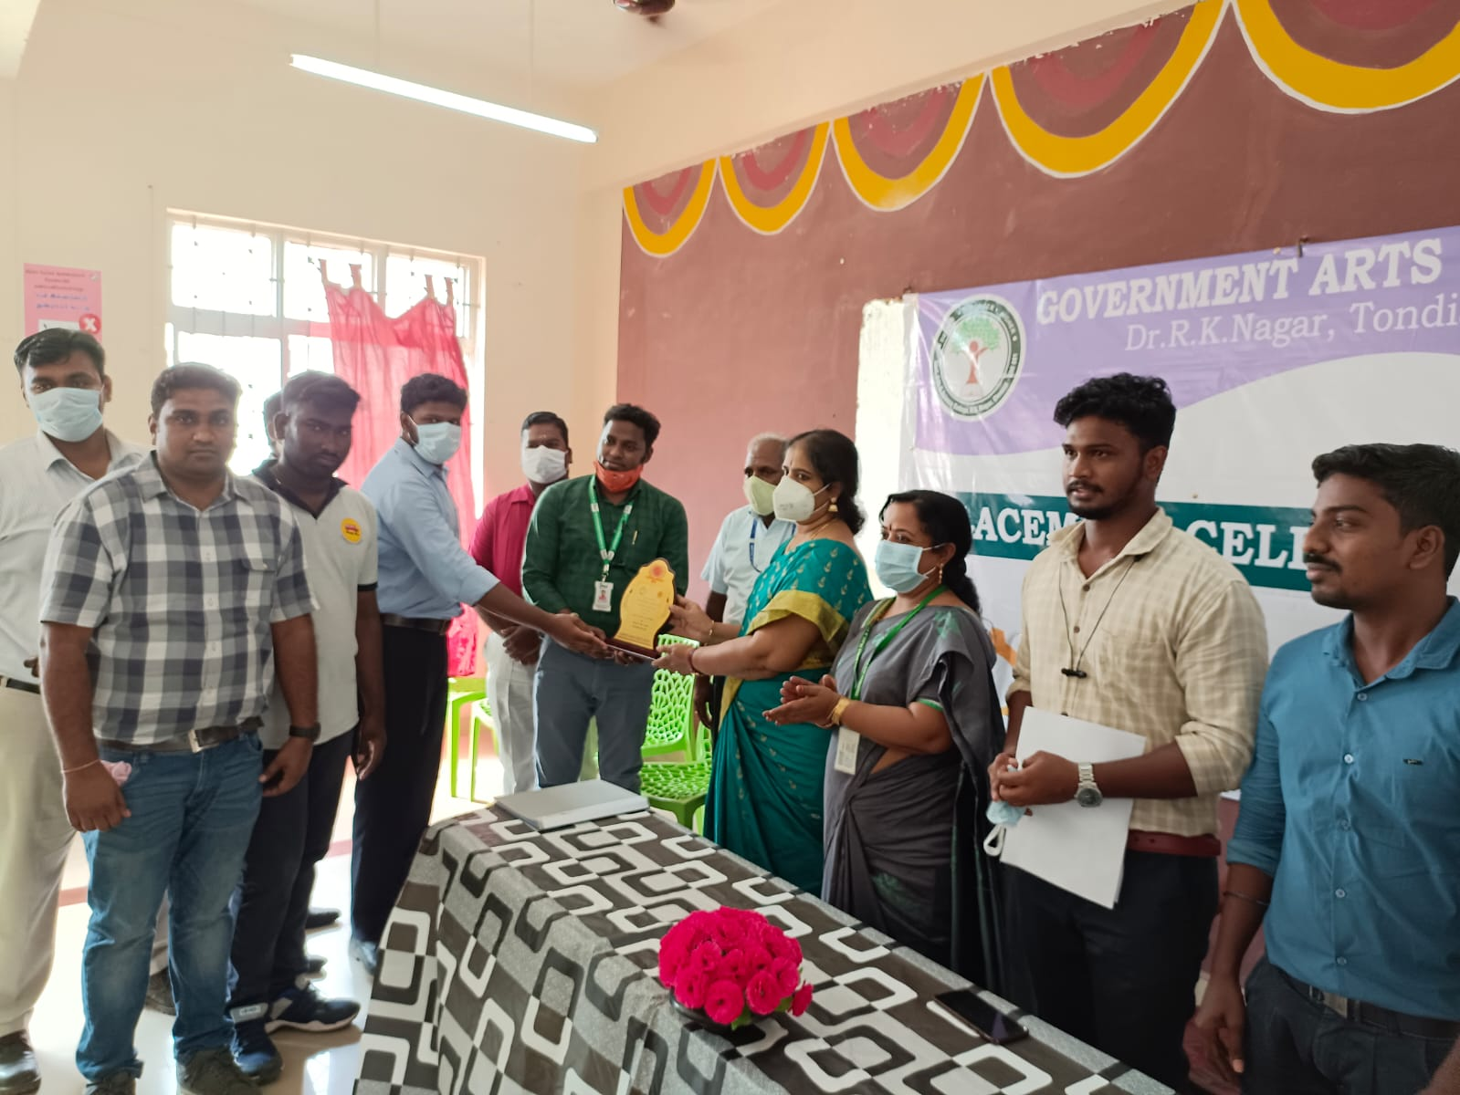
College job drives

Slide 9
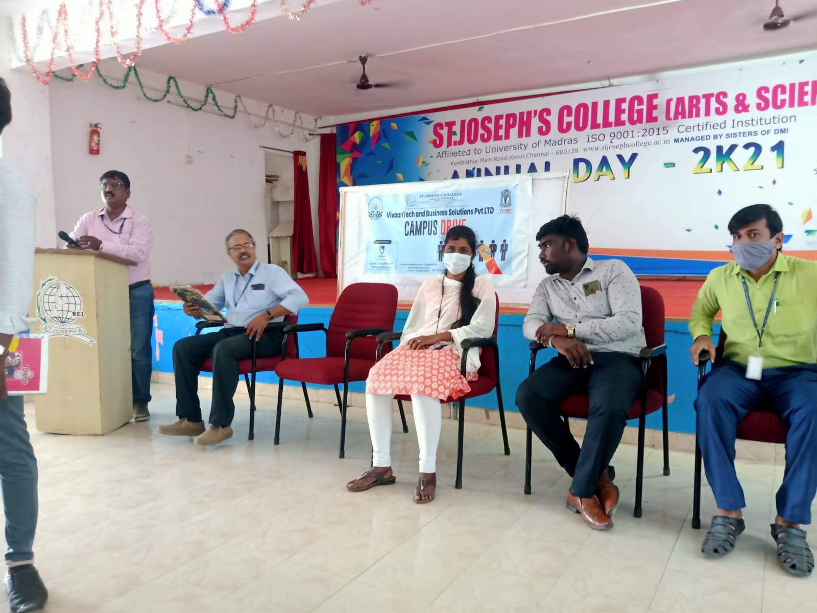
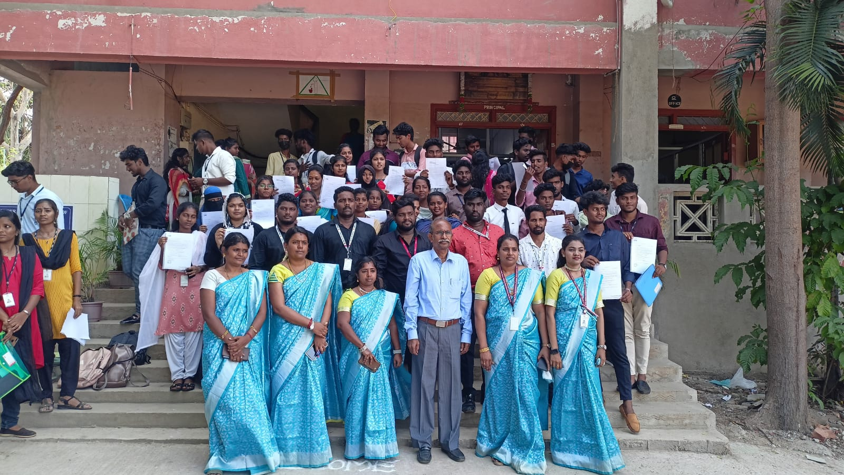
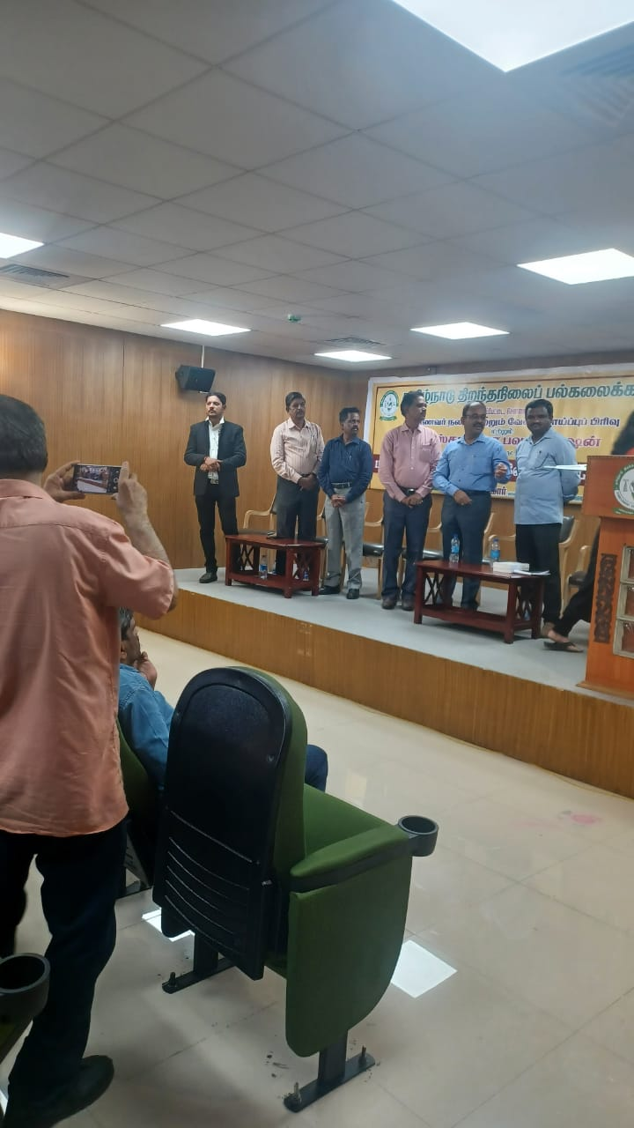
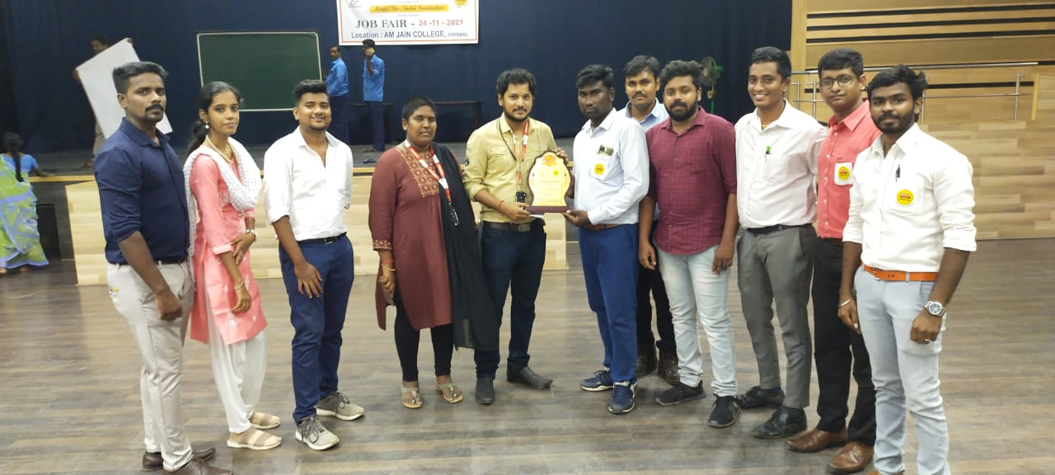

Slide 10
